Slide 1
Lecture #23
SOFT COMPUTING
INT508
Genetic Algorithm

Slide 2
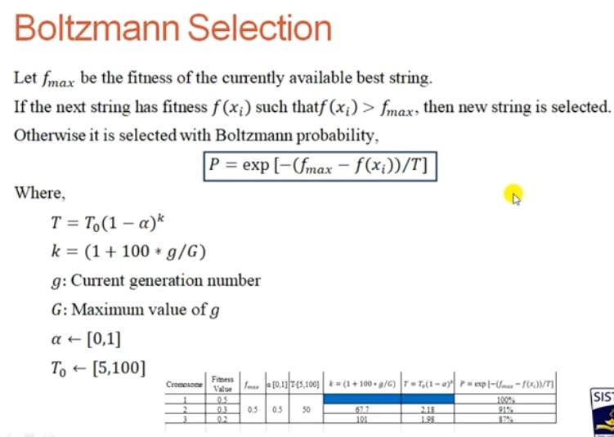
12/12/14
CSE510, Lovely Professional University, Phagwara

Slide 3
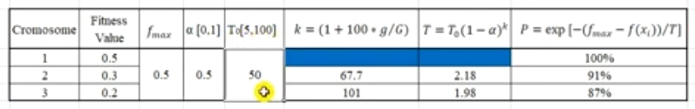
12/12/14
CSE510, Lovely Professional University, Phagwara

Slide 4
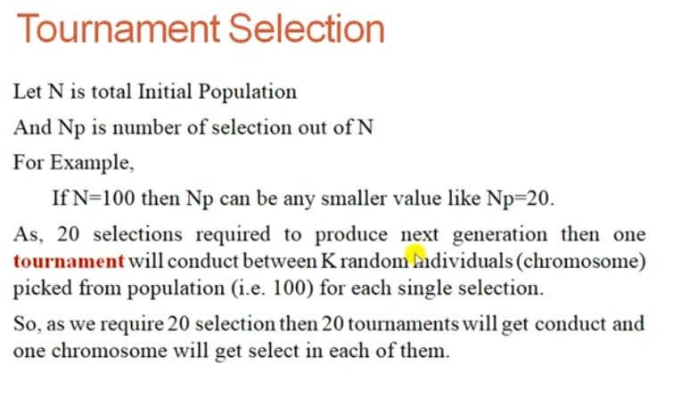
12/12/14
CSE510, Lovely Professional University, Phagwara

Slide 5
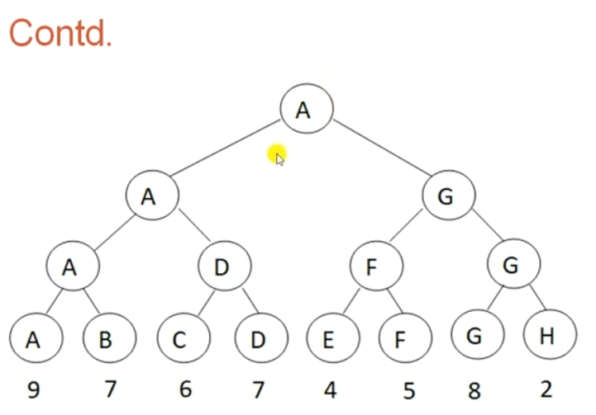
12/12/14
CSE510, Lovely Professional University, Phagwara

Slide 6
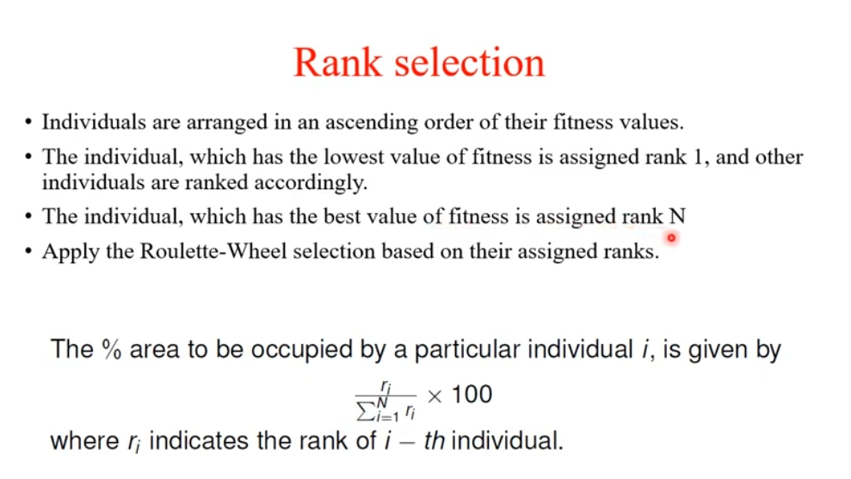
12/12/14
CSE510, Lovely Professional University, Phagwara

Slide 7
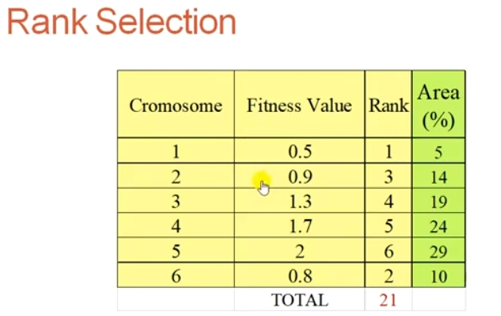
12/12/14
CSE510, Lovely Professional University, Phagwara

Slide 8
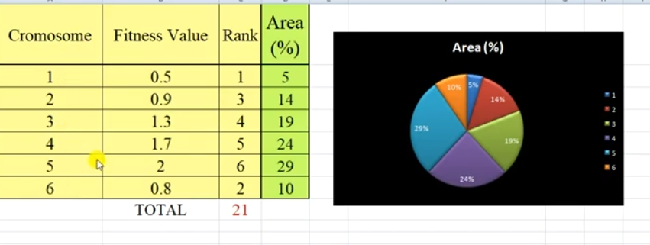
12/12/14
CSE510, Lovely Professional University, Phagwara

Slide 9
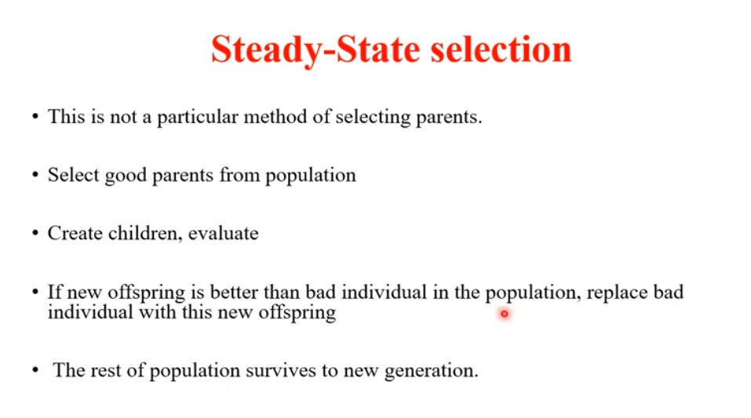
12/12/14
CSE510, Lovely Professional University, Phagwara

Slide 10
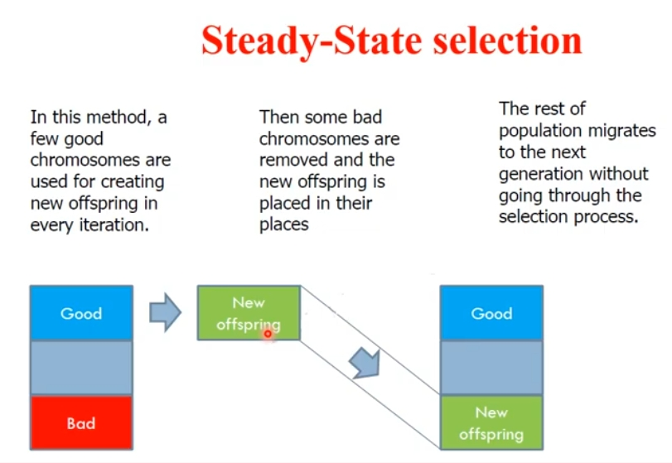
12/12/14
CSE510, Lovely Professional University, Phagwara

Slide 11
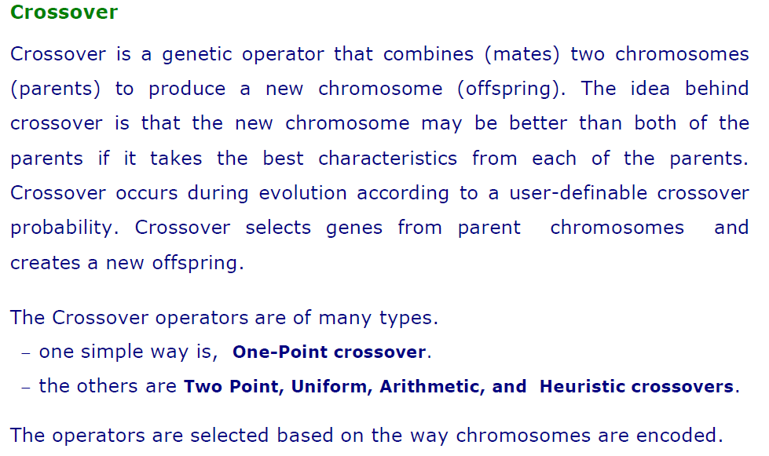
12/12/14
CSE510, Lovely Professional University, Phagwara

Slide 12
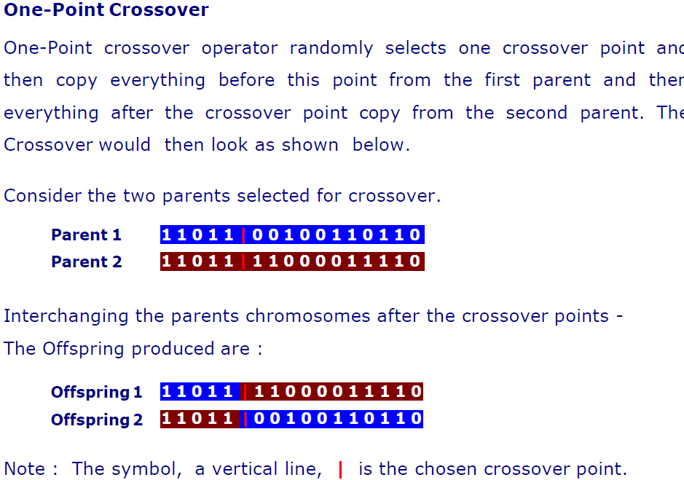
12/12/14
CSE510, Lovely Professional University, Phagwara

Slide 13
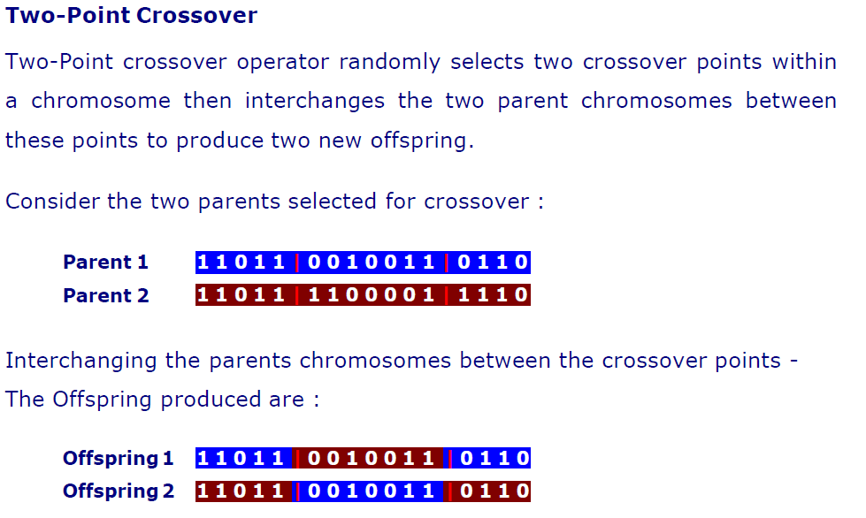
12/12/14
CSE510, Lovely Professional University, Phagwara

Slide 14
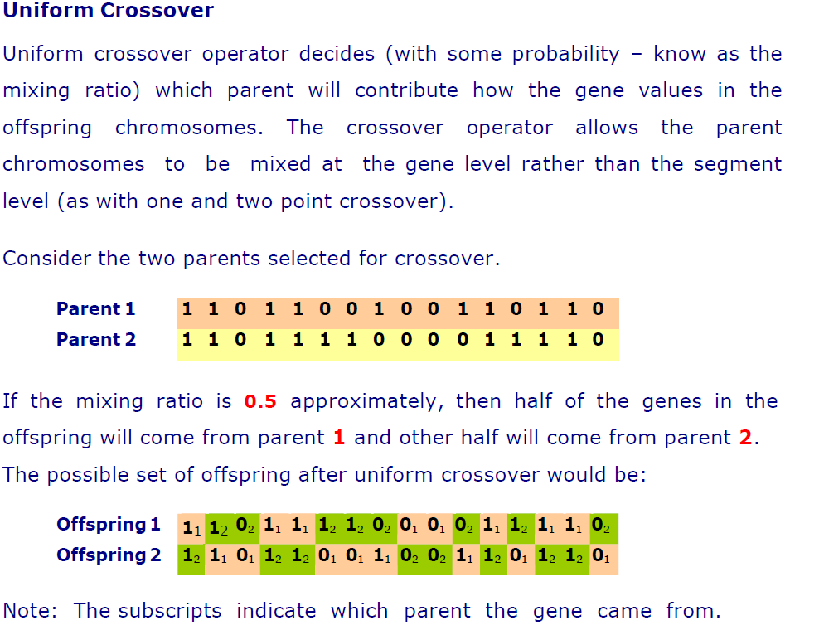
12/12/14
CSE510, Lovely Professional University, Phagwara

Slide 15
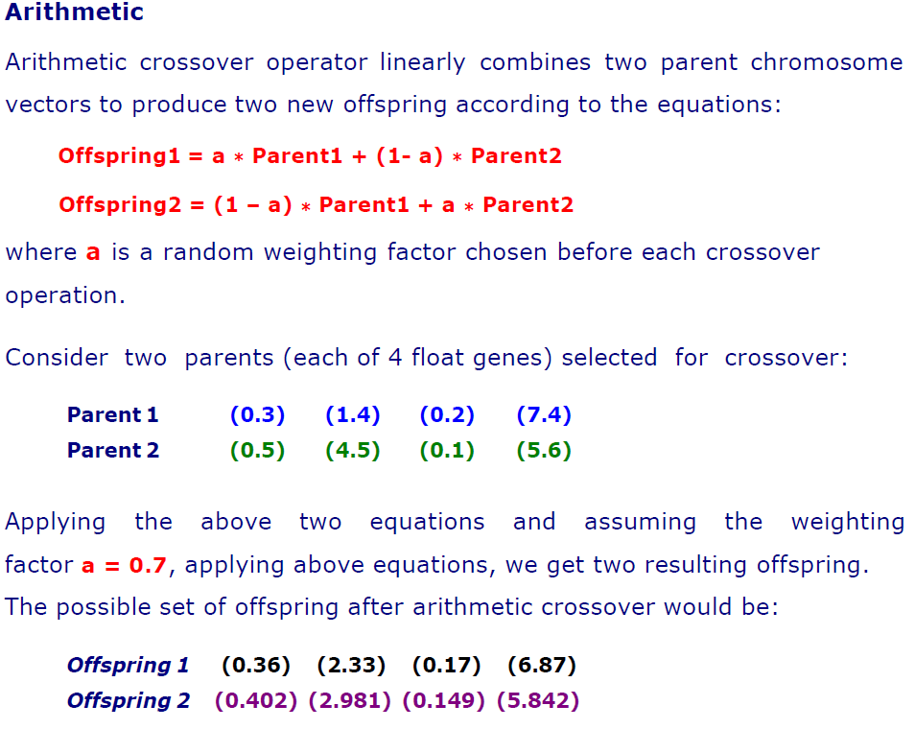
12/12/14
CSE510, Lovely Professional University, Phagwara

Slide 16
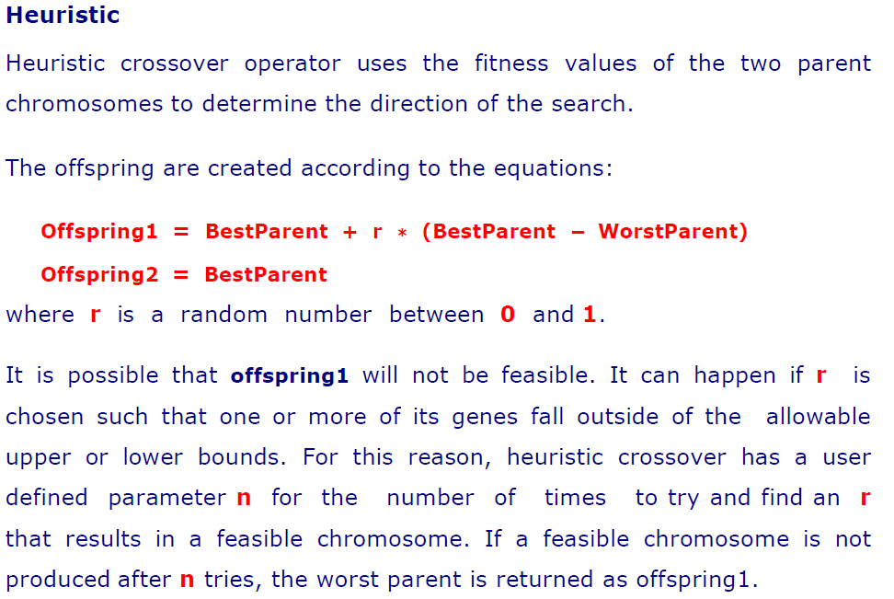
12/12/14
CSE510, Lovely Professional University, Phagwara

Slide 17
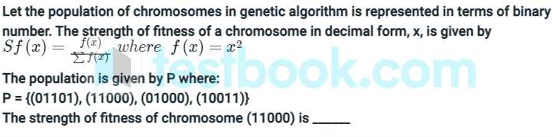
Q & A
24
576
14.4
49.2

Slide 18
Q & A
24
576
14.4
49.2

Slide 19
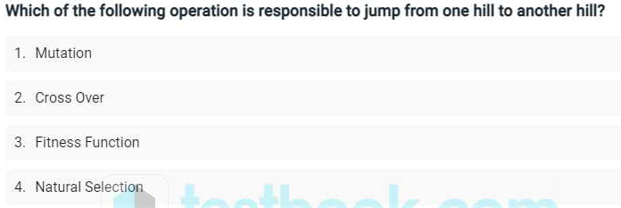
Q & A

Slide 20
Q & A
Ans: Cross Over

Slide 21

12/12/14
CSE510, Lovely Professional University, Phagwara

